Slide 1

A CLOSER LOOK AT 2017 ELECTION
Karthik Kannepalli
November 2017

Slide 2

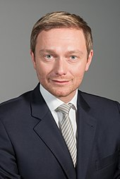

Fact sheet
Founded:
12 December 1948
Chairman:
Christian Lindner
Economic Liberalism
Social Liberalism
Free market Economy
Human Rights
Internationalism
Civil Liberties
Education
New platform
Digitalization

Slide 3
Descriptive statistical information
MEDIAN
16 441

Slide 4
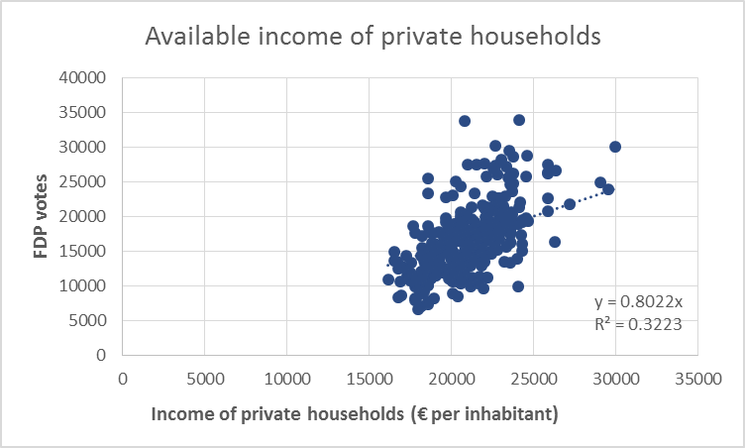
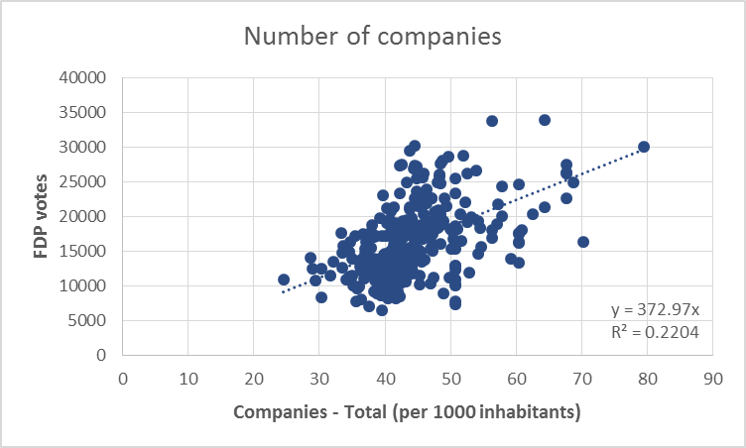
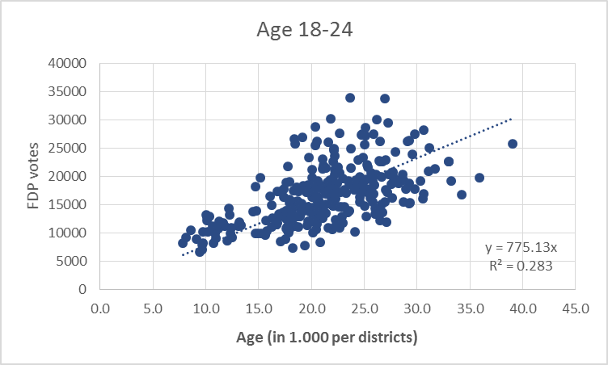
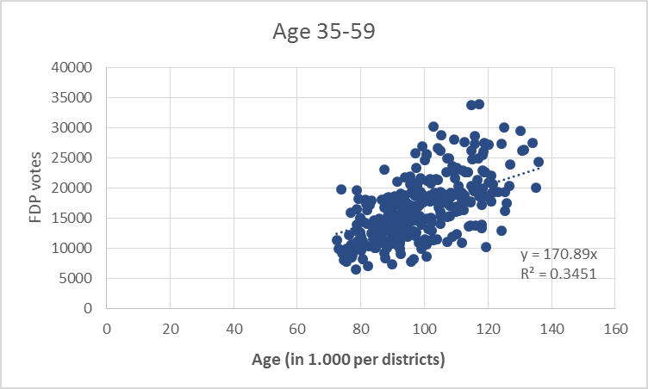
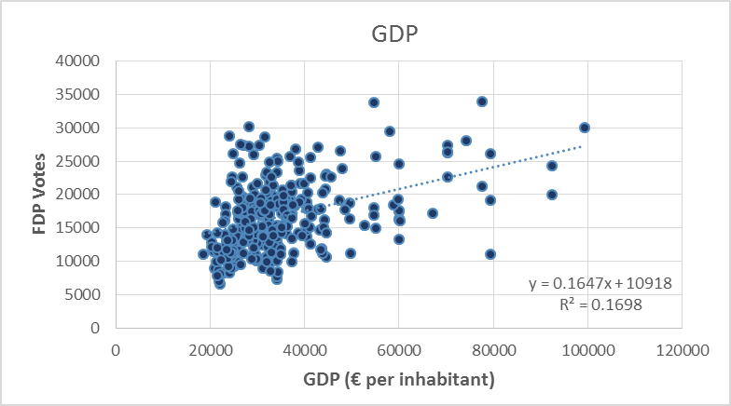
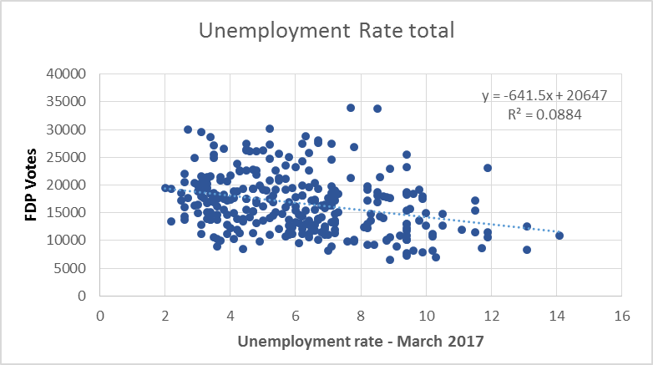
Statics Breakdown: scatterplots, parameters correlation
1
3
5
Available income of private households
Correlation | 0.63
P-value | 1.87E-34
Companies (per 1.000 inhabitants)
Correlation | 0.47
P-value | 4.24E-18
Age 18-24 vs. FDP voters
Correlation | 0.58
P-value | 1.96E-28
2
4
6
Age 35-59 vs. FDP voters
Correlation | 0.61
P-value | 1.7E-31
GDP (€ per inhabitant)
Correlation | 0.41
P-value | 1.03E-13
Unemployment rate
Correlation | -0.3
P-value | 1.55E-07

Slide 5
Multi-regression Analysis
Regression Analysis: Number of votes versus Age (35-59), Income, Migration
Model Summary
Multiple R | R-sq |  | R-sq (adj) | Standard error
78% | 61.8% |  | 61.3% | 3255.5
Coefficients
Term | Coefficient |  | Standard error Coef. | T-Stat | P-value
Intercept | -27255.7 |  | 2780 | -9.8 | 0.000
Age - 35-59 | 119.68 |  | 17.4 | 6.86 | 0.000
Income of private households (€ per inh-t) | 1.21 |  | 0.11 | 10.9 | 0.000
Age 18-25 | 211.8 |  | 44.8 | 4.72 | 0.006
Unemployment rate | 341.6 |  | 102.1 | 3.35 | 0.000
Regression Equation
FDP votes = -27255.6 +1.21*Income + 119.8 *Age (35-39) + 211.8 Age + 341.8*Unemployment

Slide 6
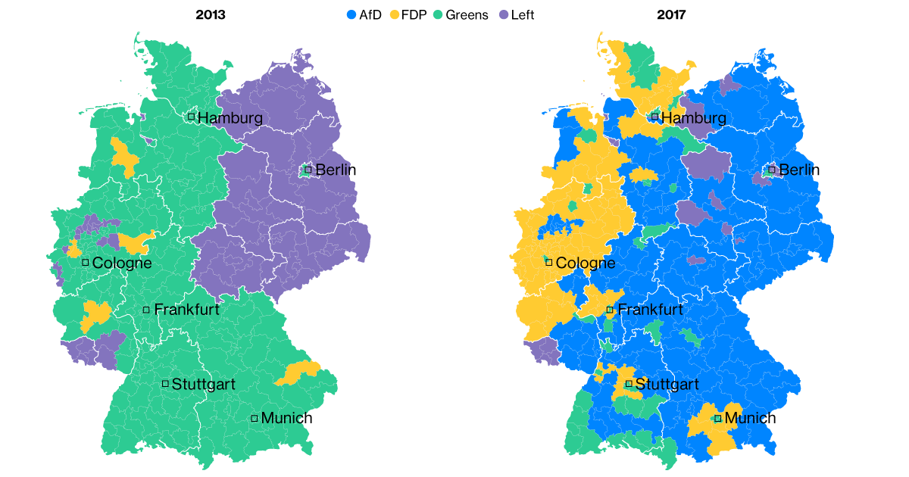
A closer look at the results
FDP 1st votes +5.6
FDP 2nd votes +7.9
CDU 1st votes -5.5
CDU 2nd votes -7.1
1
1st populated
1st youngest (18.24 , 35-59)
1st available income
1st sum of companies
1st sum of employed
1st rate of unemployment
38.6% university qualification
27.4% employed in industries
28.2% employed in services and others
*****************
Population growth upon immigrations : 14,800
Foreigner population: 11.8%
*****************
Unemployment rate7.6%
Recipients of unemployment benefit II
and of social allowance: 96,100
Foreigners receiving social benefit allowance: 33%
2
FDP 1st votes +5.7
FDP 2nd votes +6.5
CDU 1st votes -11.8
CDU 2nd votes -11.3
3
+ 5.9%
Bayern
3rd populated
3rd youngest (18.24 , 35-59)
3rd available income
3rd sum of companies
3rd sum of employed
3rd rate of unemployment
29.4% university qualification
35.9% employed in industries
24.0% employed in services and others
*****************
Population growth upon immigrations : 15,700
Foreigner population: 13.9%
*****************
Unemployment rate 3.7%
Recipients of unemployment benefit II
and of social allowance: 43,400
Foreigners receiving social benefit allowance: 39.1%

